Slide 1

Advanced spreadsheets
Lessons 5 and 6: Quiz (Part 1)

Slide 2
Objectives
In this lesson, you will learn how to:
write a series of questions, answers and feedback for a quiz
use your knowledge of drop-down lists and the VLOOKUP function to begin developing a self-marking quiz using a spreadsheet.

Slide 3
Quiz
You are going to use your knowledge of spreadsheets to create a five-question self-marking quiz.
Your quiz should include four questions that use drop-down lists to allow the user to select their answer and one question that uses check boxes.
You will need to record a macro to calculate the score and give bespoke feedback for each answer selected.
Finally, you will need to record a macro to reset the spreadsheet ready for the next user.
Now watch Video 5.1

Slide 4
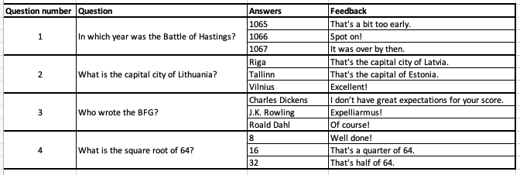
Questions using drop-down lists
The first task is to write the four questions that will use drop-down lists.
Each question must have three answers to choose from.
Each answer must have bespoke feedback.

Slide 5

Activity 5.1: Quiz questions (Part 1)

Slide 6
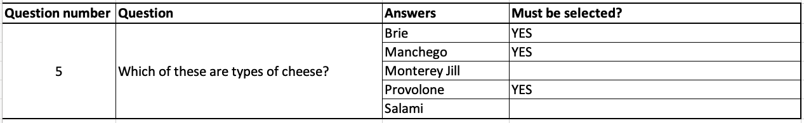
Question using check boxes
Your last question needs to allow the user to select their answer using check boxes.
The question needs to have five answers to choose from.
To be correct the question should require three, and only three, of the boxes to be ticked. You will need to indicate which of the three answers needs to be ticked.

Slide 7
Activity 5.1 Quiz questions (Part 2)

Slide 8
Setting up the drop-down questions
You are now going to begin developing your quiz spreadsheet.
Type the first four questions into the spreadsheet.
Create look-up tables, on the right-hand side of the spreadsheet, for Questions 1 to 4, listing the answers and the feedback for each answer.
Use the look-up tables to create drop-down lists to select the answers.
Add VLOOKUP functions to give the appropriate feedback when each answer is selected.

Slide 9
Activity 5.2: Quiz (Part 1)

